Slide 1
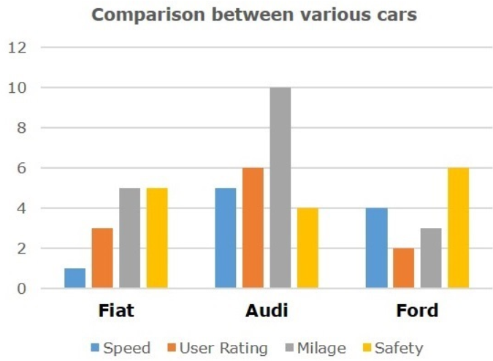
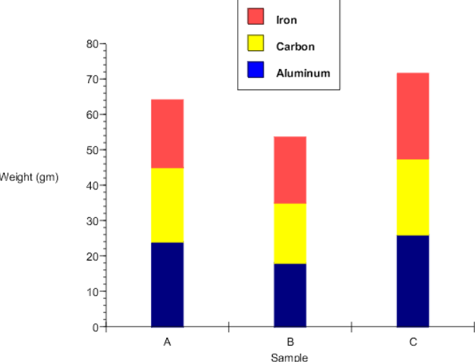
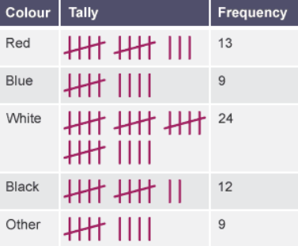
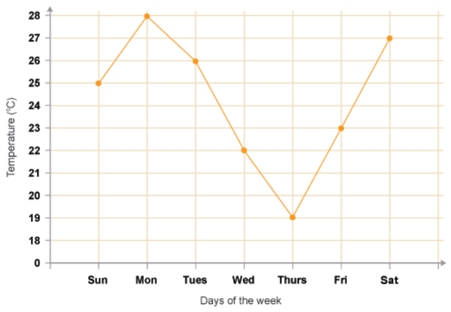
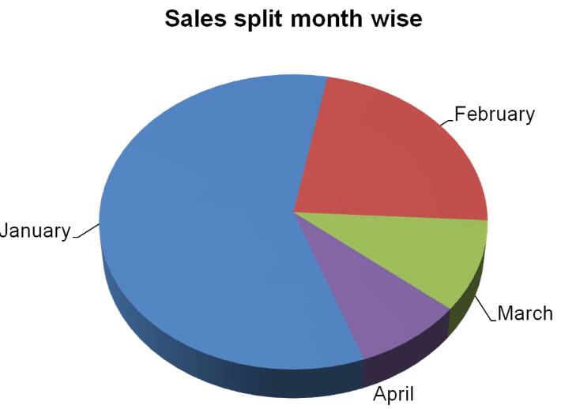
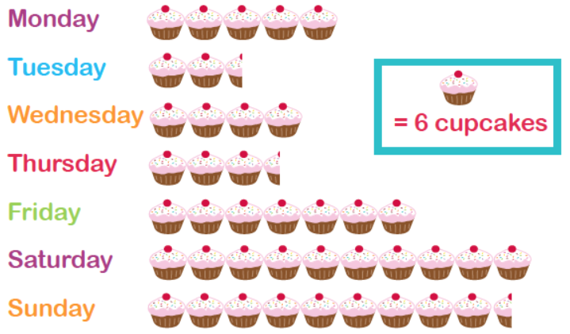
TYPES OF DATA AND GRAPHS
Statistics
Key Concepts
Comparative bar charts
Examples
Composite bar charts
Discrete data: data that can be categorised into a classification, there are a finite number of classifications.
E.g. Hair colour, shoe size, number of children in a class.
Continuous data: data that can take any value. Data that is measured.
E.g. Height, weight, time.
Qualitative data: data that describes something.
E.g. Race, ethnicity.
Quantitative data: data that is in numerical form.
E.g. Statistics, percentages, time.
Tally charts
Line graphs
Pie charts
Pictograms
Key Words
Data
Discrete
Continuous
Qualitative
Quantitative
Graph
What types of data is each of the following?
Number of goals scored in a match
Eye colour
Time it takes to run 100m
4) Length of a car
5) Number of pets a person owns
15, 16, 63, 64, 65
ANSWERS: 1) Discrete, quantitative 2) Discrete, qualitative 3) Continuous, quantitative
4) Continuous, quantitative 5) Discrete, quantitative

